Slide 1


Gender Responsive Budgeting in Agriculture

Slide 2

Workshop Agenda
Day 1
Time | Activity
9:00 AM - 9:30 AM | Introduction
9:30 AM - 10:0 AM | Rationale of GRB in Agriculture
10:00 AM - 11:30 AM | Principles of Gender Responsive Budgeting
11:30 AM – 12:45 PM | Case Studies: GRB Implementation in Agriculture
12:45 PM – 2:00- PM | Lunch Break
2:00 PM – 3:00 PM | GRB in Organizational Processes GRB in Policies and Management
3:00 PM – 4:00 PM | GRB in Program Development – Guidelines 1
4:00 PM – 5:00PM | Break and Day 1 Review

Slide 3
Workshop Agenda
Day 2
Time | Activity
9:00 AM - 9:30 AM | Recap of Day 1 and Introduction to Day 2
9:30 AM - 10:30 AM | GRB in Program Development – Guidelines 2
10:30AM – 12:00AM | Developing GRB indicators + M&E
12:00 AM – 12:45 PM | Group discussion: Challenges and solutions
12:45 PM – 2:00- PM | Lunch
2:00 PM – 3:00 PM | Developing Action Plans for GRB Implementation
3:00 PM – 4:30 PM | Group Work: Action plans and feedback
4:30 PM – 5:00PM | Closing

Slide 4
Gender Responsive Budgeting in Agriculture

Slide 5


What is Gender Responsive Budgeting?
GRB involves integrating a gender perspective into the budgeting process, ensuring that financial allocations consider the diverse roles, interests, experiences, and contributions of both women and men.
This Photo by Unknown author is licensed under CC BY-ND.

Slide 6

What is Gender Responsive Budgeting?
Gender-responsive budgeting (GRB) is an essential approach in fostering gender equality and addressing the unique needs and challenges faced by women and men in various sectors, including agriculture, across the African continent.

Slide 7
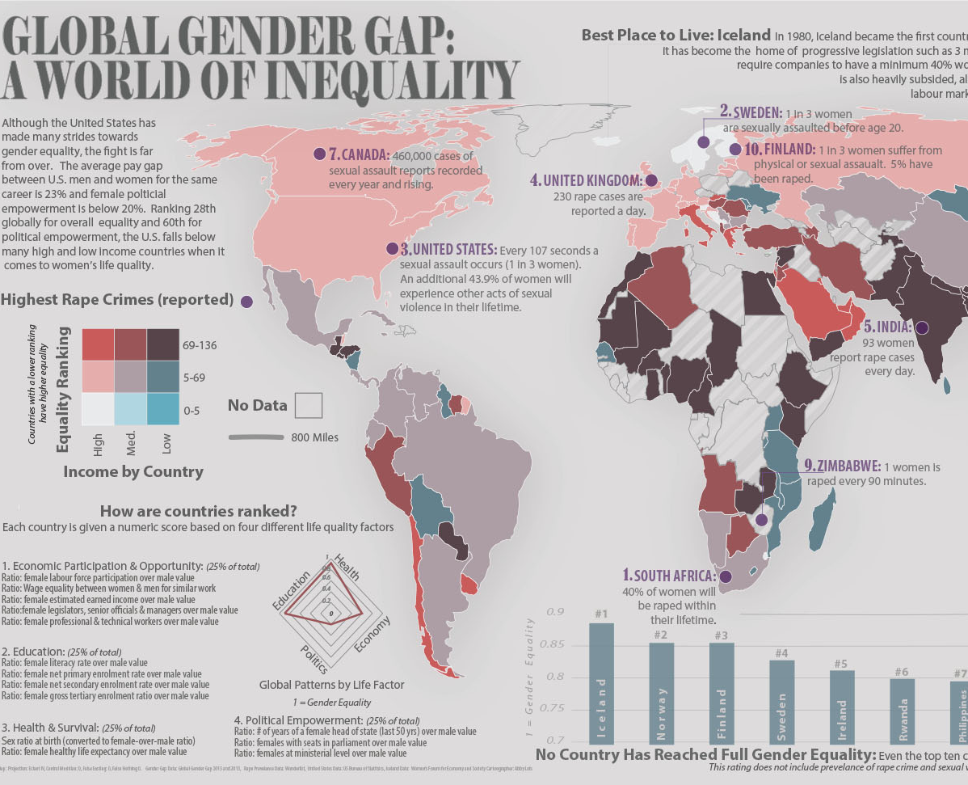
What is Gender Responsive Budgeting?
In Africa, where gender disparities persist in multiple domains, including education, employment, and access to resources, GRB is crucial in promoting inclusive development.
The agricultural sector, a significant contributor to many African economies, is particularly relevant in this context.
This Photo by Unknown author is licensed under CC BY-NC-ND.

Slide 8
Rationale for Gender Responsive Budgeting in Agriculture?
Globally, agrifood systems are crucial sources of employment for women, often serving as a primary livelihood.
In Africa, despite the increasing feminization of agriculture, women's contributions are often overlooked in policies, programs, budgets, and formal support systems.
However, women commonly face marginalization in these systems, encountering subpar working conditions compared to men. This inequality includes unequal, informal, casual, unskilled, and time-consuming work, contributing to their vulnerability.

Slide 9
Rationale for Gender Responsive Budgeting in Agriculture?
Women shoulder a disproportionate burden of unpaid care work, limiting their educational and employment opportunities.
Cultural norms and obstacles related to accessing resources impede their participation in valuable agrifood systems roles.
To address these issues, GRB Integrates a gender perspective into the budgeting process, ensuring that financial allocations are equitable and responsive.

Slide 10

Benefits of implementing GRB in Agriculture
Equity and Equality: GRB in agriculture ensures fair resource allocation, addressing historical gender disparities in equal access to agricultural inputs, extension training, financial services, and technology for both men and women.
Empowerment of Women: GRB targets investments to benefit women, enhancing their access to resources, land ownership, and active participation in agricultural decision-making.
Enhanced Agricultural Productivity: Allocating resources to improve women's access to quality inputs, leads to increased yields, diversified crops, and more resilient farming practices.
Notes:
3. Enhanced Agricultural Productivity: Women's involvement in agriculture is vital for food security. By allocating resources to improve women's access to quality inputs, training, and technology, we can enhance agricultural productivity, leading to increased yields, diversified crops, and more resilient farming practices.

Slide 11
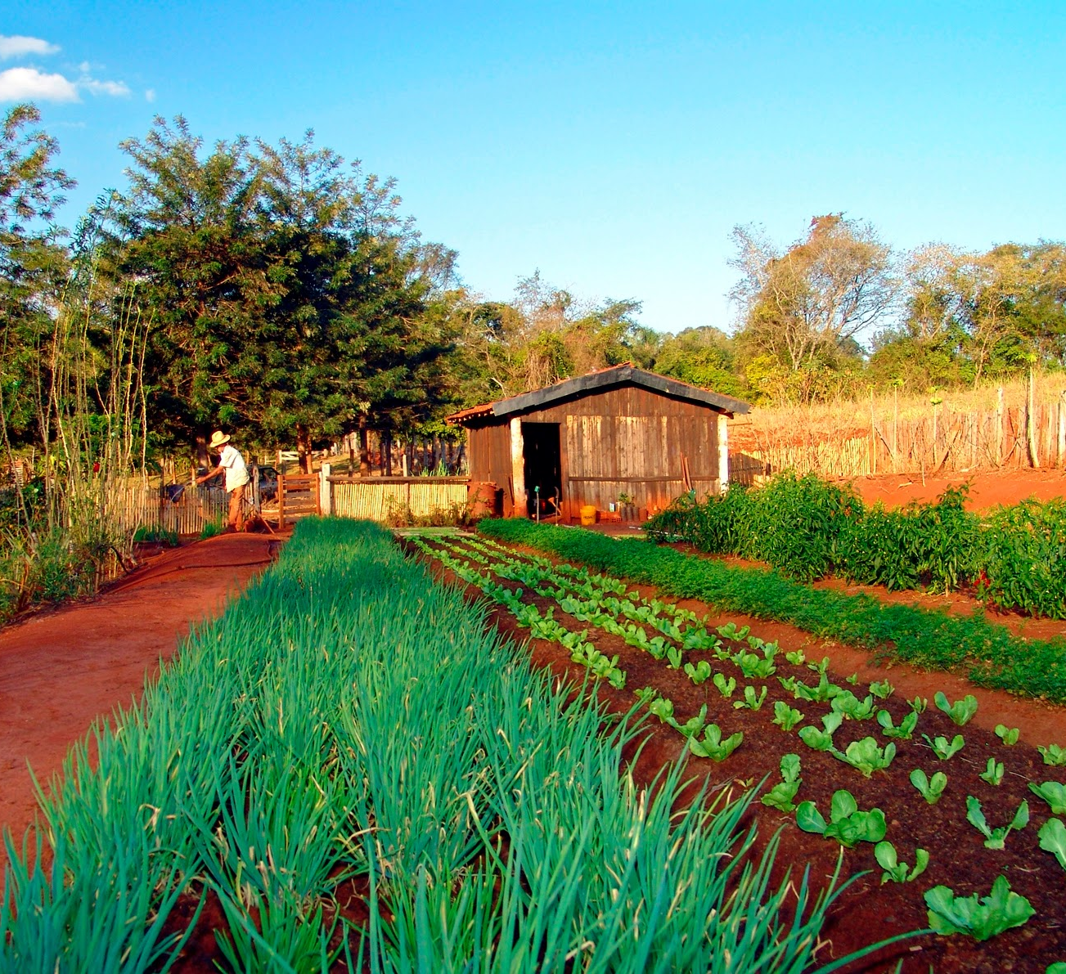
Benefits of implementing GRB in Agriculture
5. Rural Development: Aligning budgetary allocations with gender perspectives in agriculture contribute to better living standards and reduced poverty in rural areas.
6. Inclusive Policies: GRB promotes inclusive policy formulation in agriculture, addressing the diverse needs of both women and men.
This Photo by Unknown author is licensed under CC BY-SA.
Notes:
5. Rural Development: Aligning budgetary allocations with gender perspectives in agriculture fosters balanced growth in rural communities. Investments in women's education, health, and income opportunities contribute to elevated living standards and reduced poverty in rural areas.
6. Inclusive Policies: Gender-responsive budgeting promotes inclusive policy formulation in agriculture, addressing the diverse needs of both women and men. This results in policies that specifically tackle challenges faced by women, including access to maternal healthcare, childcare, and achieving work-life balance.

Slide 12

Benefits of implementing GRB in Agriculture
7. Better Governance: GRB promotes transparent, accountable, participatory and democratic governance structures.
8. Data-Driven Decision Making: Data-driven approach informs policymakers to design targeted interventions
9. Sustainable Development: GRB supports environmentally friendly and resilient agricultural practices.
Notes:
Better governance: Gender-responsive budgeting promotes transparent and accountable governance by insisting on women's inclusion in decision-making processes related to budget allocation and expenditure tracking.
Data-Driven Decision Making: Incorporating gender into agricultural budgeting involves collecting and analyzing gender-disaggregated data. This data-driven approach informs policymakers, enabling them to design targeted interventions addressing the specific needs of women and men in agriculture.
9. Sustainable Development: Incorporating gender into agricultural budgeting contributes to achieving sustainable development goals by recognizing women's roles in resource management and environmental conservation. Gender-responsive budgeting supports environmentally friendly and resilient agricultural practices.

Slide 13
Principles of Gender Responsive Budgeting
Principles
Gender equity and equality
Economic growth and development
Accountability
Transparency
Efficiency and effectiveness
Participation
Human rights

Slide 14

Principles of Gender Responsive Budgeting
1. Human Rights: GRB safeguards individuals' human rights, irrespective of gender, by directing budgetary allocations to address the specific needs of women and vulnerable groups, promoting social justice and inclusivity.
2. Accountability: GRB emphasizes accountability in resource allocation, holding governments and organizations responsible for effective fund utilization..
This Photo by Unknown author is licensed under CC BY-NC-ND.
Notes:
Accountability ensures equitable financial resource allocation and efficient program implementation for the benefit of both men and women

Slide 15

Principles of Gender Responsive Budgeting
3. Transparency: A cornerstone of GRB, transparent budgeting processes enable stakeholders to understand resource allocation, facilitating the identification of disparities and advocacy for change.
This Photo by Unknown author is licensed under CC BY-NC-ND.
Notes:
This transparency builds trust between citizens and governments, fostering civic participation.

Slide 16

Principles of Gender Responsive Budgeting
4. Participation: GRB encourages active stakeholder participation, especially women, in the budgeting process.
Notes:
Women's engagement in decision-making ensures comprehensive and effective policies, empowering them to voice concerns and shape budgetary priorities

Slide 17

Principles of Gender Responsive Budgeting
5. Efficiency and Effectiveness: Vital principles in GRB, efficiency, and effectiveness ensure resources are allocated based on gender-specific needs, maximizing the impact of programs.
Notes:
Targeted investments in women and gender equality initiatives yield higher returns in social and economic development.

Slide 18

Principles of Gender Responsive Budgeting
6. Economic Growth and Development: GRB recognizes that promoting gender equality significantly contributes to economic growth. By investing in women's education, livelihoods, and economic empowerment, GRB enhances the labor force, encourages entrepreneurship, and stimulates sustainable economic progress.
This Photo by Unknown author is licensed under CC BY-NC-ND.

Slide 19

Principles of Gender Responsive Budgeting
7. Gender Equity/Equality: At its core, GRB aims for gender equity and equality by challenging existing gender norms and biases. It ensures budgetary decisions do not reinforce inequalities, promoting policies that level the playing field for men and women across all sectors of society.
This Photo by Unknown author is licensed under CC BY-NC.

Slide 20

CRB in Agriculture Sector in African Countries
The Republic of Benin - 2013
The Budget Office reformed public procurement policies to be more gender-sensitive. The Gender Budgeting initiative in Benin received funding from the German Technical Cooperation Agency and the United Nations Development Program.
This Photo by Unknown author is licensed under CC BY-SA.

Slide 21
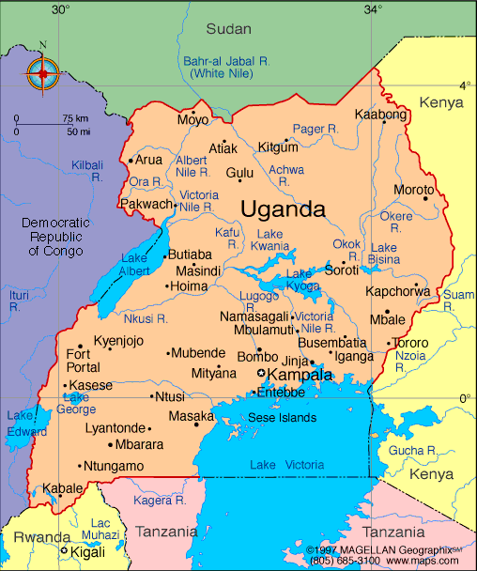
CRB in Agriculture Sector in African Countries
Uganda- 1990
UNIFEM pioneered gender budgeting in Senegal, initially training officials and civil society and later advocating for gender mainstreaming in budget call circulars. Collaborating with legislators in 2008 resulted in the inclusion of gender-oriented issues in budget call circulars and the Poverty Reduction Strategy Paper. Concurrently, the Ministry of Agriculture developed a gender-aware budget and a report on women's needs.
This Photo by Unknown author is licensed under CC BY-NC.

Slide 22

CRB in Agriculture Sector in African Countries
Cameroun – 2009
As of 2009, the Gender Budgeting initiative was overseen by a collaborative team monitored at both ministerial and national government, particularly focusing on capacity building for GRB. UN Women has been the primary donor and supporter of gender budgeting in Cameroon.
Tanager

Slide 23
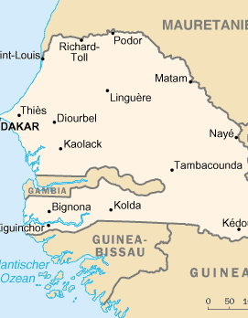
CRB in Agriculture Sector in African Countries
Senegal- 2009
UNIFEM pioneered gender budgeting in Senegal, focusing on gender equality and poverty reduction. The initiative initially trained public officials and civil society actors, transitioning to policy advocacy for gender mainstreaming in budget call circulars. In 2008, collaboration with legislators led to the incorporation of gender-oriented issues in budget call circulars and the Poverty Reduction Strategy Paper. Concurrently, the Ministry of Agriculture developed a gender-aware budget and a report highlighting women's needs.
This Photo by Unknown author is licensed under CC BY-SA.

Slide 24

CRB in Agriculture Sector in African Countries
The Gambia – 2011
In The Gambia, gender-responsive budgeting was implemented by the executive arm of the government, involving the office of the Vice President, the Minister for Women, and the Ministries of Education, Health and Social Welfare, and Agriculture.

Slide 25

CRB in Agriculture Sector in African Countries
Ghana - 2008
In 2008, Ghana's government began implementing Gender-Responsive Budgeting (GRB) with an initial focus on the Ministries of Food and Agriculture, Health, and Education. A steering group was formed, and staff from these ministries were trained, while budget guidelines from 2008 to 2010 emphasized the collection of sex-disaggregated data in preparation for future GRB implementation.
This Photo by Unknown author is licensed under CC BY.

Slide 26

CRB in Agriculture Sector in African Countries
Tanzania – 1997
Tanzania initiated gender budgeting in 1997. In 2010, the Ministry of Finance issued gender-specific instructions to government agencies, particularly the Ministries of Agriculture and Labour. The Agricultural sector supported impoverished families, many headed by females, with funds for farming inputs.
Notably, Ethiopia's 1997 land certification program significantly improved women's legally recognized land rights, providing expanded commercial farming and rental market opportunities.

Slide 27

Rwanda: Land Tenure Reform and Gender Equality in Agriculture
Land Tenure Reform
Government introduced land tenure reform policies that aimed to secure women's land rights and promote their active participation in agriculture.
Initiative Highlights
Land Tenure Reform
Women's Land Use
Collective Farming
Impact of the initiative
Increased women's ownership of agricultural land and assets.
Improved access to credit and extension services for women farmers.
Enhanced gender equity in decision-making within households and communities.
Higher agricultural productivity due to increased involvement of women.

Slide 28
Nigeria: Electronic Wallet System for Female Farmers
Ministry of Agriculture – GWIN
Ministry of Agriculture – through the GWIN Programme distributed two million mobile telephones to female farmers to better their access to and trade information especially to start making use of e- wallet method of purchasing agricultural inputs i.e., seeds and fertilizers.
Initiative Highlights
E-wallet (electronic wallet) system, an innovative and motivational mobile technology designed to assist farmers to access agricultural inputs, without the intervention of middlemen. 30,000 women trained on improved farming methods.
Impact of the Initiative
- Tackled corruption in the fertilizer sector
- Eliminated the exploitative practices of intermediaries in the fertilizer supply chain.
- Female farmers' access to subsidized fertilizers, enabling them to secure
- Better access to improved seeds and restoring their trust in government interventions.

Slide 29
GRB Guidelines:
Processes, Policy and Management

Slide 30
Operationalizing GRB
1. Leadership: The presence of political will and policy commitment from leaders. 2. Policies: Gender unit, gender strategy, gender tools, and organogram. 3. Human Resources: Gender experts, gender courses, gender-inclusive facilities, and gender integration into programs. 4. Financial Resource: Ensure there are GRB principles in budget allocations, and budget allocations support policy and advocacy efforts aimed at gender equality. 5. Monitoring and Evaluation: Ensure the organization is collecting and analyzing data that is gender-disaggregated and has gender-sensitive indicators. 6. Organizational Development and Sustainability: Ensure the organization creates synergy and partnerships with other stakeholders promoting gender-responsive efforts.

Slide 31
Operationalizing GRB in leadership
Leadership
Is there a high-level commitment within the organization to make budgets promote gender equality?
Does senior management display a commitment to gender equality?
Are there advocates for gender-responsive budgeting (GRB) among board members and in management positions?
Has GRB been integrated into institutional planning?
Have appropriate GRB tools been identified and used to inform policies, programs, and budget requests?
Are staff encouraged or rewarded for integrating gender equality into their work?

Slide 32
Operationalizing GRB in leadership
Policies
Does the organization have a gender policy
Is there a dedicated gender unit within the organization?
Does the organizational structure facilitate coordination and formal roles for gender focal points and the gender unit in the budget process?
Has the organization incorporated GRB principles into its strategies and policies
Is the organization actively advocating for gender-responsive policies within its sector or industry?

Slide 33
Operationalizing GRB in human resources and personnel management
Human Resources and Personnel Management
Does the organization have a workforce that is sufficiently aware and capable of implementing GRB?
Does the organization invest in training and capacity development programs on gender-sensitive budgeting for its staff and stakeholders?
To what extent does the organization promote a gender-inclusive and equitable workplace culture?
Are there budget allocations to support initiatives that foster such a culture?
Do all staff have the knowledge and capacity to effectively practice GRB?
Is there a budget for gender mainstreaming efforts, including staff training and capacity-building on gender-responsive approaches?
Does the organization engage in partnerships and collaborations with gender-focused organizations to enhance its gender-responsive efforts?

Slide 34
Operationalizing GRB in Resource Allocation
Financial Resource Allocation
How is the organization distributing its financial resources among various programs and projects?
To what extent are budget allocations supporting gender-specific initiatives?
Do budget decisions contribute to or mitigate gender disparities within the organization and its operations?
Do budget allocations support policy advocacy efforts aimed at gender equality?
Is there a budget to support staff to attend gender related capacity building forums?
v

Slide 35

GRB Guidelines: Programmatic work

Slide 36
Operationalizing GRB in Project Design
Guidelines | Checklist Questions - project design
Ensure that the program logical framework incorporates gender equality priorities, strategic objectives, and envisioned outcomes. | Does the program incorporate gender equality priorities, strategic objectives, and envisioned outcomes?
Ensure the organization programs are informed by gender analysis of the gender landscape in the respective sector, community, or environment, taking into account the distinct experiences and needs of men, women, boys, and girls. | Does the program incorporate gender equality priorities, strategic objectives, and envisioned outcomes? Does the program address both practical gender needs (PGNs) and strategic gender needs (SGNs). Are men and women actively engaged in all phases of the program, encompassing its design, planning, budgeting, implementation, monitoring, and evaluation? Do the program staff demonstrate gender equity and facilitate activities targeting individuals of all genders?

Slide 37
Operationalizing GRB in Project Design
Guidelines | Checklist Questions - project design
Ensure program’s result framework is gender sensitive. | Are program priorities, strategic objectives, and intended outcomes attuned to gender sensitivity? Are the program’s result frameworks gender sensitive?
Ensure there is a monitoring and evaluation frameworks are designed to be gender-sensitive. | Do the monitoring and evaluation frameworks designed to be gender-sensitive, ensuring that gender equality considerations are integral to the assessment process. Do the program incorporates the collection of sex-disaggregated data to enhance gender-specific analysis and reporting. Are the program indicators crafted to be gender-sensitive and enable the measurement of progress toward gender equality? Gender equality objectives, targets, and indicators adhere to the SMART criteria

Slide 38
Operationalizing GRB: Credit Providers
Guideline | Checklist – Financial/credit providers
Ensure financial service provider sets aside budget to facilitate women access to financial services e.g. women targeted loans, savings accounts for agricultural services. | Is there a budget set aside to facilitate women's access to financial services, such as loans and savings accounts tailored to their needs and agricultural activities?
Ensure organizations offer financial literacy training to meet the differentiated needs of both men and women. | Does the financial service provider offer financial literacy training programs customized to meet the specific needs of women farmers?
Ensure organization provides family sensitization activities to empower. | Does the service provider offer family sensitization activities that empower women to exert control over or jointly manage family income and agricultural products?
Ensure loan/credit eligibility criteria does on perpetuated existing exclusion of women | Is the eligibility criteria achievable by women based on prevailing norms? Are there concessions to accommodate women?

Slide 39
Operationalizing GRB: Producers/Cooperatives/ Farmer associations
Guideline | Checklist – Producer, cooperatives, farmers associations
Ensure your community/farmer association/cooperative promote gender equality in land and property rights within the agriculture sector | Does your community/farmer association/cooperative actively promote gender equality in land and property rights within the agriculture sector?
Ensure community/farmer associations/cooperative have land titling and registration support particularly emphasizing women's land rights. | Are there budgetary allocations designated for land titling and registration, particularly emphasizing women's land rights?
Ensure both men and women have access and control over various production factors. | Do both men and women have access and control over various critical production factors, including land, microfinance, agricultural labor, fertilizers, and agricultural extension services?

Slide 40
Day 2

Slide 41
Operationalizing GRB: Input Suppliers
Guideline | Checklist
Ensure input supplier has budget allocation aimed at granting women access to improved seeds, fertilizers and agricultural technology. | Are there budget allocations aimed at granting women access to improved seeds, fertilizers, and agricultural technology?
Ensure input supplier offer training and support programs to help women effectively utilize agricultural technologies | Does input supplier offer training and support programs to help women effectively utilize agricultural technologies?

Slide 42
Operationalizing GRB: Aggregators and Transporters
Guideline | Checklist
Aggregators Ensure aggregators/storage service providers have a designated budget for conducting gender analysis of aggregator operations to comprehend gender specific challenges opportunities and dynamics within supply chain. | Is there a designated budget for conducting gender analyses of aggregator operations to comprehend the gender-specific challenges, opportunities, and dynamics within your supply chain? Identify areas where gender inequalities may exist and develop programs to address them.
Transporters Ensure transporters in agricultural sector receive trainings and support for gender sensitive transport services. | Do you provide training and support to transporters in the agricultural sector to offer gender-sensitive transport services?
Tanager

Slide 43
Operationalizing GRB: Traders, Processors and Millers
Guideline | Checklist
Traders Ensure traders/retailers have budgets allocated for initiatives that enhance participation of women in agricultural value chains and improve access to markets. | Is there a budget allocated for initiatives that enhance the participation of women in agricultural value chains and improve their access to markets? Do you provide support for women’s entrepreneurship and facilitate market linkages for women involved in agriculture?
Processors/Millers Ensure there is a budget for initiatives that promote increased participation of women in agricultural processing and packaging. | Is there a budget for initiatives promoting increased participation of women in agricultural processing and packaging?

Slide 44
Operationalizing GRB: Monitoring and Evaluation
Checklist
Does the organization generate and utilize sex-disaggregated statistics and other data?
Is the organization collecting and analyzing data disaggregated by gender to identify gender-specific needs and challenges?
Is there an established system for tracking and evaluating the gender impact of the organization's budgetary decisions and programs?
How is this data being used to inform budgetary choices?
Is gender-sensitive indicators used to assess progress?
Are information and monitoring systems designed to be gender-sensitive?
Is sex-disaggregated data collected in all organization programs and activities?

Slide 45

How to Monitor and Evaluate GRB
Steps involved in monitoring and evaluating gender budgeting initiatives:
Step 1: Situation Analysis
Step 2: Assessing Policy Gender-Responsiveness
Step 3: Budget Allocation Assessment
Step 4: Monitoring Expenditures and Service Delivery
Step 5: Outcome Assessment
Notes:
Monitoring and evaluating gender budgeting initiatives is crucial to gauge their impact on gender equality and ensure that budget allocations and policies are responsive to gender-specific needs and disparities. Below is a breakdown of the steps involved in effectively monitoring and evaluating gender budgeting initiatives

Slide 46
Indicators for GRB
 | Indicators
Leadership | Output indicator There exists a gender policy that is implemented by management. Action plans for policy implementation exist and are tracked. Gender champions among board members Underrepresented persons eg women are members of governance board
Policy | Output indicators Existing gender policy, gender strategy, strategy implementation plan that incorporates GRB. Gender units/departments exist within the organization's organogram. Outcome indicator Operational gender policy and/or strategy.

Slide 47
Indicators for GRB
 | Indicators
Human Resources | Output indicators Existence of GRB modules for onboarding and capacity building of staff Existence of gender inclusive facilities Existence of gender expert/lead staff Existence of departmental incentives for GRB integration Outcome indicator Increased awareness of staff on GRB
Finance resource allocation (FRA) | Output indicators FRA Proportion of budget allocated to gender specific initiatives.

Slide 48
Indicators for GRB
 | Indicators
Monitoring and evaluation indicators | Output indicators Proportion of projects that have gender analysis embedded in baseline/formative assessments Proportion of projects that utilize gender analysis findings/recommendations in their interventions How can we measure utilization of data to inform budgeting decisions? Evidence generated from M&E data to guide decision making or project design. Documented lessons used to inform budgeting processes
Organizational development and sustainability | Output indicators Number of partnerships/engagements in enhancing GRB. Number of budget decisions aligned with nation/international commitments. Outcome indicators: Enhanced partnerships and collaborations on GRB

Slide 49
Indicators for GRB : Programs Cycle
 | Indicators
Programs cycle | Output indicators Proportion of budget allocated for gender equality activities including identification of program beneficiaries for general mainstreaming, and evaluation activities. Number of collaborative meetings conducted between gender unit and project units on GRB. Outcomes indicators Increased budgetary allocation to gender responsive initiatives. Increased responsiveness to differentiated gender needs and interests. Increased access to opportunities for women in Agric – land, microcredit. Increased participation in decision- making for both men and women, historically excluded populations. Increased number of collaborative meetings on GRB held between Gender unit and project units.

Slide 50
Programs Cycle: Checklist
 | Program Aspect | Questions to Consider
1 | Program Design and Objectives | Were the agriculture programs designed with a clear understanding of gender-specific needs and challenges? Are the program objectives explicitly inclusive of both male and female beneficiaries?
2 | Participation and Inclusivity | Was there a deliberate effort to ensure the active participation of both genders in agriculture program activities? Were marginalized or vulnerable groups within each gender considered in the program's outreach?
50

Slide 51
Programs Cycle: Checklist
 | Program Aspect | Questions to Consider
3 | Access to Agricultural Resources | Were agricultural resources (land, seeds, fertilizers, etc.) equally accessible to male and female beneficiaries? Were there any observed gender-based barriers to accessing agricultural resources?
4 | Training and Capacity Building | Were agricultural program benefits and impacts measured separately for male and female beneficiaries? Were there any gender-based disparities in the outcomes of the agriculture programs?
Tanager

Slide 52
Programs Cycle: Checklist
 |  | Checklist
5 | Economic Empowerment | - Did the agriculture programs contribute to economic empowerment for both male and female participants? - Were there mechanisms in place to address any gender-based disparities in income or economic opportunities within the agriculture sector?
6 | Health and Safety in Agriculture | - Were health and safety measures in agriculture activities designed to address gender-specific needs? - Were there measures to ensure the reproductive health and safety of both male and female participants in agriculture programs?
Tanager

Slide 53
Programs Cycle: Checklist
 |  | Checklist
7 | Community Engagement in Agriculture | - Was there active engagement with the community to understand gender dynamics and needs in the context of agriculture? - Were efforts made to address any gender-based challenges within the target communities related to agriculture programs?
8 | Monitoring and Evaluation in Agriculture | - Were gender-disaggregated data regularly collected and analyzed to assess the effectiveness of agriculture programs? - Was there a feedback mechanism for agricultural beneficiaries to express gender-specific concerns?
9 | Sustainability and Long-Term Impact | - Were there considerations for ensuring the sustainability of agriculture program benefits for both genders over the long term? - Did the agriculture programs contribute to positive, lasting changes in gender relations within the target agricultural communities?

Slide 54
Challenges of Implementing GRB in the Agriculture Sector
Limited awareness
Misaligned policies
Donor indifference
Structural inequalities
Resource constraints

Slide 55
Opportunities to Implementation of GRB
There is considerable donor interest in gender-responsive budgeting initiatives.
Donors are progressively advocating for projects that aim to achieve gender transformative outcomes, with gender–responsive budgeting as a critical catalyst.
Empowering women across various sectors of agriculture underscores the importance of implementing gender-responsive budgeting frameworks.
Women-owned organizations, farmer’s groups, cooperatives, and other collectives led by women should prioritize engagement in gender-responsive learning initiatives
55

Slide 56
Enablers of GRB Operationalization
1. Leadership: the presence of willingness and policy commitment from leaders.
2. Policies: Gender unit, gender strategy, gender tools, and organogram.
3. Human Resources: Gender experts, gender courses, gender-inclusive facilities
4. Financial Resource: Budget allocations to support policy and advocacy efforts aimed at gender equality.
5. Monitoring and Evaluation: Collecting and analyzing data that is sex disaggregated with gender-sensitive indicators.
6. Organizational Development and Sustainability: Partnerships with other stakeholders promoting gender-responsive efforts.

Slide 57
Developing Action Plans for GRB Implementation

Slide 58

Group work

Slide 59
Thank You

